Slide 1
CSU Gender Summit: Plenary Session
THINGS TO KNOW ABOUT TITLE IX
Sandra E. Hodgin, PhD
Assistant Director of Title IX Compliance and Programs
Jennifer Mayhew, JD
Assistant Director for Complaints and Disabilities, Office of Equal Opportunity

Slide 2
“No person in the united states shall, on the basis of sex, be excluded from participation in, be denied the benefits of, or be subjected to discrimination under any education program or activity receiving Federal financial assistance.”
Title IX, Education Amendment of 1972

Slide 3
What Issues Does
Title IX Include…
Prohibits Sex Discrimination
    Sexual assault
    Sexual harassment
    Hazing
    Interpersonal violence (Dating and Domestic Violence)
    Pregnancy or parental status inequities
    Athletics inequities
*Please turn to your neighbor and mention the issues you feel it includes.

Slide 4



History of Title IX
Bernice Sandler (“Godmother of Title IX”)
1972 Title IX Education Amendment​
Supreme Court Decisions​ (1990’s)
Department of Education’s Office of Civil Rights​ (1997 & 2001 Guidance Letters)
NEW Proposed Regulations

Slide 5
Institutional actions, policy, and practices are not culturally neutral (Adelman et al., 2012).
RESEARCH TO KEEP IN MIND @ GENDER SUMMIT
On school campuses, less than 10% of student sexual violence cases are reported to police or school administrators (Krebs, Linquist, Shook-Sa, & Peterson, 2016).
Students and Staff are important groups that should receive strategic prevention education training because most victims disclose sexual victimization and sexual misconduct to informal supports, such as friends and significant others rather than contacting law enforcement or victim advocate groups (Hodgin, 2018; DeMatteo et al., 2015; Fisher, Daigle, Cullen, & Turner, 2003; Krebs et al., 2009).

Slide 6
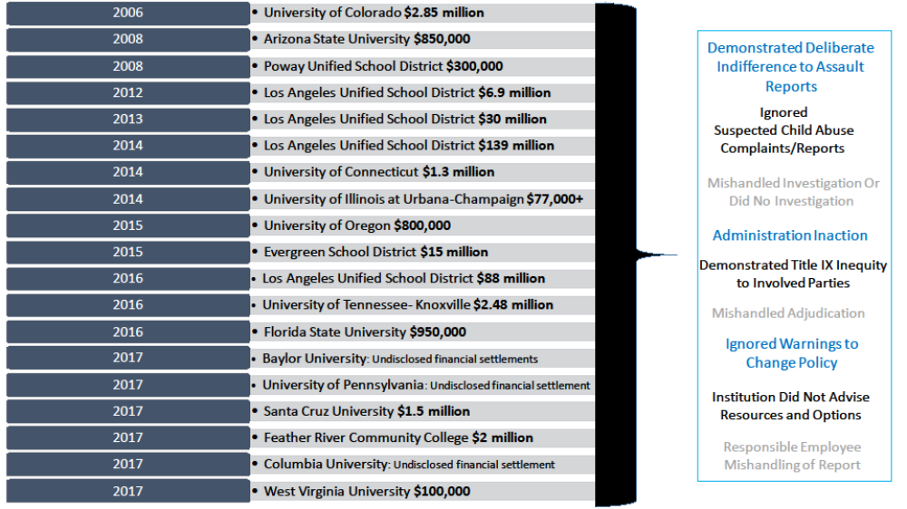
What non-compliance liability has looked like in recent years
© Copyright. Sandra E. Hodgin, 2018. All rights reserved.

Slide 7
Is Title IX related to the topic of ‘rape culture’?
Take a Moment
YES!
        Defined by Oxford Dictionary (2018), rape culture is described as “a society or environment whose prevailing social attitudes have the effect of normalizing or trivializing sexual assault and abuse.”

Slide 8

Why Title IX is important for ALL
As an employee or employer (Title VII)
As a parent, uncle, aunt, guardian, etc.
As a co-worker, friend, family member
*IMPORTANT DETAILS WE SHOULD UNDERSTAND @ CSU:
  Types of inappropriate behaviors to be aware of and what to report
  Where Title IX campus policies are located and what the policy describes
  Resources that are available on- and off- campus for both employees and students

Slide 9
A) EXCLUDED FROM PARTICIPATION IN
B) DENIED THE BENEFITS OF
C) TREATED DIFFERENTLY FROM OTHERS, OR
D) OTHERWISE ADVERSELY AFFECTED IN A
TERM OR CONDITION OF EMPLOYMENT,
EDUCATION, LIVING ENVIRONMENT OR
UNIVERSITY PROGRAM OR ACTIVITY
DISCRIMINATION

Slide 10
- A Professor only offers extra credit to male identified students.
- Fewer athletic scholarship dollars offered to women’s sports compared to men’s sports.
- Only Graduate Students and Employees who identify as women are asked for input on parental leave.
EXAMPLES OF POSSIBLE DISCRIMINATION

Slide 11
a) Conduct is sexual in nature or based on person’s actual or perceived gender and, b) Conduct is unwanted/unwelcome
SEXUAL HARASSMENT

Slide 12
- Sexual advances, requests for sexual favors
- Sexual ridicule
- Stereotyping based on actual or perceived gender
- Frequent jokes about sex or gender
- Repeatedly asking a person out for dates
- Attempted or actual sexual assault
EXAMPLES OF POSSIBLE
SEXUAL HARASSMENT

Slide 13
- Office of Equal Opportunity https://oeo.colostate.edu/
- Support and Safety Assessment/Title IX Programs http://supportandsafety.colostate.edu/home.aspx
- Faculty and Administrative Professional Manual https://facultycouncil.colostate.edu/faculty-manual/
- University Policy Library http://policylibrary.colostate.edu/
Discrimination, Harassment, Sexual Harassment, Sexual Misconduct, Domestic Violence, Dating Violence, Stalking and Retaliation Policy

Slide 14
Informal Resolution
- Use of conflict resolution techniques
- Mutually acceptable outcome
Formal Resolution
- Objective and impartial investigation
- Determination reached
Confidentiality
Non-Retaliation
OEO PROCEDURES

Slide 15
Required to report incidents of possible gender discrimination or sex harassment involving a student, including student employees
Report to Title IX Coordinator or Deputy Title IX Coordinator for Employment within 24 hours
Not a confidential resource
RESPONSIBLE EMPLOYEE

Slide 16
-POLITELY INTERRUPT
-Inform that you are a responsible employee and there are some things you cannot keep confidential
-Share resources
-Demystify the process
-Offer Support
HOW TO RESPOND

Slide 17
EMPLOYEE RESOURCES
(ON- AND OFF- CAMPUS)
Confidential Support Off-Campus
Employee Assistance Program (EAP)
Provides counseling and crisis intervention services.
(800) 497-9133
(970) 491‐1527
EAP Online Access: https://www.guidanceresources.com/groWeb/login/login.xhtml
*Company Web ID: CSUEAP (Use this ID to create an account)
Website: https://ombudsandeap.colostate.edu/employee-assistance-program/
(Note: There are 6 free Counseling sessions offered through EAP (per family member))
Sexual Assault Victim Advocate Center (SAVA)
Provides counseling, crisis intervention, and advocacy services.
970‐472‐4200 (24-Hour Rape Crisis Hotline)
970‐472‐4204 (Fort Collins Office)
Crossroads Safehouse (Domestic Violence)
Provides counseling, crisis intervention, and advocacy services.
970-482-3502 (24-Hour Crisis Hotline)
970‐530‐2353 (Fort Collins Office)
Rape, Abuse & Incest National Network (RAINN)
Provides counseling by phone or live online communication.
1‐800‐656‐4673 (24-Hour National Crisis Hotline)
Online Chat: https://hotline.rainn.org/online/
Confidential Support On-Campus (100%)
Office of the Ombudsperson
Provides conflict resolution and negotiation support and services.
(970) 491-5121
Website: https://ombudsandeap.colostate.edu/csu-ombuds-office/
Confidential Support On-Campus (Need-To-Know)
Office of Equal Opportunity (OEO)
OEO provides assistance in matters related to equal opportunity, affirmative action, and non-discrimination. Also, this office assists with complaints of discrimination and harassment.
(970) 491-5836
Website: https://oeo.colostate.edu/
Non-Confidential Support If an Emergency Dial: 9-1-1
Student Case Management
Provides crisis prevention and intervention services.
(970) 491-8051
Website: http://www.studentcasemanagement.colostate.edu/home
Tell Someone
Tell Someone provides you professional access to discuss mental health or safety concerns that you may have about a student or employee on campus.
(970) 491-1350
Website: http://www.supportandsafety.colostate.edu/tellsomeone
CSU Police Department Fort Collins Police Department
(970) 491-6425 (non-emergency) (970) 221-6540 (non-emergency)

Slide 18
Confidential Support Off-Campus
Sexual Assault Victim Advocate Center (SAVA)
Provides counseling, crisis intervention, and advocacy services.
970‐472‐4200 (24-Hour Rape Crisis Hotline)
970‐472‐4204 (Fort Collins Office)
Crossroads Safehouse (Domestic Violence)
Provides counseling, crisis intervention, and advocacy services.
970-482-3502 (24-Hour Crisis Hotline)
970‐530‐2353 (Fort Collins Office)
Rape, Abuse & Incest National Network (RAINN)
Provides counseling by phone or live online communication.
1‐800‐656‐4673 (24-Hour National Crisis Hotline)
Online Chat: https://hotline.rainn.org/online/
Non-Confidential Support If an Emergency Dial: 9-1-1
CSU Police Department Fort Collins Police Department
(970) 491-6425 (non-emergency) (970) 221-6540 (non-emergency)
Student Case Management
Provides crisis prevention and intervention services.
(970) 491-8051
Website: http://www.studentcasemanagement.colostate.edu/home
Tell Someone
Tell Someone provides you professional access to discuss mental health or safety concerns that you may have about a student or employee on campus.
(970) 491-1350
Website: http://www.supportandsafety.colostate.edu/tellsomeone
STUDENT RESOURCES
(ON- AND OFF- CAMPUS)
Confidential Support On-Campus
CSU Health and Medical Center Counseling Services
Provides counseling and spiritual care services.
970‐491‐6053
970-491-7111 (After-hours)
Monday – Friday, 8am- 5pm.
Women’s Care Services at CSU Health Network
Provides women care services that includes but is not limited to woman examinations, birth control counseling, and sexual transmitted infection (STI) testing, counseling, and treatment.
970‐491‐1754
Monday – Friday, 8am- 5pm.
Women and Gender Advocacy Center: Victim Assistance Team (VAT)
Provides counseling, crisis intervention, and advocacy services.
970‐492‐4242 (24-Hour Hotline)
970‐491‐6384 (WGAC Office)
Monday – Friday, 8am-5pm.
Email: wgac@colostate.edu

Slide 19
THANK YOU
GENDER SUMMIT PARTICIPANTS!

