Slide 1
Relationship Wellness
Boundaries: Why do we need them and How do we set them?
Jan Pierce, MS, LPC
Employee Assistance Program, Campus Liaison
(970) 491-1527
Sandra E. Hodgin, PhD
Title IX Compliance & Programs, Assistant Director
(970) 491-1557
Michelle Jacoby, MSW
Tell Someone, Coordinator
(970) 491-5196

Slide 2
Relationships
RELATIONSHIP
WELLNESS
SELF-CARE
BOUNDARIES

Slide 3
Brene Brown on Boundaries
Play Brene Brown Boundaries Link (play to min 2.52)
Brene’s definition: “What is okay and what is not okay” simple right
“The most compassionate people I have interviewed over the last 13 years were also the most boundaried”
“What if people are doing the best they can?”
BIG: “What boundaries need to be in place for me to stay in my integrity an make the most generous assumptions about you”
NOTHING IS SUSTAINABLE WITHOUT BOUNDARIES

Slide 4
What are Boundaries?
Boundaries define us by revealing what is me and what is not me
Physical Boundaries: Set by who can touch you and how and where. How close you allow other to be in physical distance. (have an awareness of cultural differences)
Emotional Boundaries: Set by how you will allow other to treat you. You set limits on what others can say to you, whether or not you will tolerate certain jokes or innuendoes, and determining how much personal information you will reveal.

Slide 5
How can we learn to set Boundaries
Learn to say NO. No is a very important boundary setting word
Learn to express your opinion
Find out who you are (identity and self esteem work)
Think about your SELF. What do you like and dislike? What do you value? What are your interests?
When you protect yourself from even a small boundary violation you send a powerful message to yourself: “I am strong”, “I am safe”, “I can protect myself”, “I am valuable”

Slide 6
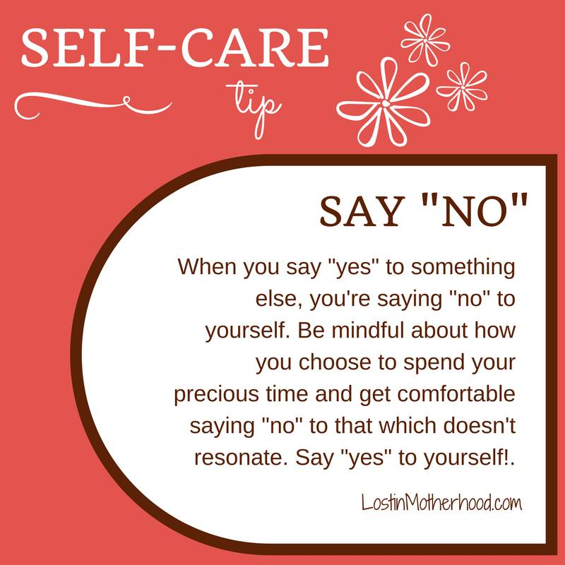

Slide 7


Slide 8
Assessment and Goal Planning
Meditation Exercise
"When we are depleted our giving is empty. Today I Take a moment to recharge, fill up with love for my life and all if its character so that I may give from a place of overflowing."
-Lisa Wemberger

Slide 9
Healthy and unhealthy relationships
Relationships
RELATIONSHIP
WELLNESS
SELF-CARE
BOUNDARIES

Slide 10
The Relationship Spectrum (loveisrespect.org)
ALL RELATIONSHIPS
Healthy Relationships
Unhealthy Relationships
Abusive Relationships
RESPECT
GOOD COMMUNICATION
TRUST
HONESTY
EQUALITY
PRESSURE
DISHONESTY
INCONSIDERATE BEHAVIOR
STRUGGLE FOR CONTROL
COMMUNICATION BARRIERS
ACCUSATIONS
BLAME SHIFTING (DEFLECTING RESPONSIBILITY)
ISOLATION & JEALOUSY
MANIPULATION
OBSSESSIVE INTENSITY

Slide 11
Let's Identify Types of Relationships
(I.e., Healthy, Unhealthy, Abusive)
Unhealthy
Abusive
Healthy
If you have a disagreement, your partner uses the silent treatment and won't talk to you for days.
When you go to your favorite restaurant and order something different, your partner acts disgusted and calls you stupid for ordering it.
You miss your partner when you go on vacation with your family, but you have a really good time anyway.
Your partner appreciates your passions and encourages you to do the things you love.
Your partner says you don't really love them because you want to go to a movie with a friend instead of spending time alone with them .
Healthy
Unhealthy

Slide 12
Why is it important to understand Boundaries, Relationships, and Self-Care?
To proactively form healthy relationships in the workplace and in your personal lives.
To identify what unhealthy relationships are to: (1)attempt to improve them, and (2) establish boundaries and self-care.
To identify what abusive relationships are and become aware of your rights in the workplace and/or in your personal life to prevent and end this type of relationship.
    Protections at the Workplace:
    Title IX and Title VII
    Protections in your Personal Life:
    Title 42, Section 10606: Public Health and Welfare, Victim's Rights

Slide 13
POST-IT ACTIVITY
"STICK IT TO LOVE"

