Slide 1
TITLE IX
Sandra E. Hodgin, PhD
Sandra.Hodgin@colostate.edu
Office #: (970) 491-1557

Slide 2
“No person in the United States shall, on the basis of sex, be excluded from participation in, be denied the benefits of, or be subjected to discrimination under any education program or activity receiving Federal financial assistance.”
Title IX, Education Amendment of 1972

Slide 3



History of Title IX and its campus influence today
Bernice Sandler (“Godmother of Title IX”)
1972 Title IX Education Amendment​
Supreme Court Decisions​
Department of Education’s Office of Civil Rights​ (1997 & 2001 Guidance Letters)
NEW Proposed Regulations (Comment Period Closed January 28th : Regulations.gov )

Slide 4
Overview of Title IX Regulations
Current Title IX Regulations (proposed to be amended)
Proposed Title IX Regulations (2019 proposed sections)
34 CFR 106.3 (Remedial action by DOE/OCR; campus responsibility)
34 CFR 106.6 (Governing laws and obligations)
34 CFR 106.8(a) (TIX coordinator designee) – 2001 Revised Sex. Harassment Guidance
34 CFR 106.8(b) (grievance procedures adopted and published) - 2001 Revised Sex. Harassment Guidance
34 CFR 106.9 (dissemination of policy)
34 CFR 106.12 (religious exemption)
106.44 & 106.45: removes
remedial action by DOE (OCR); Clarifies campus responsibility re: deliberate indifference (1998- Gebser v. Lago Vista Indep. S.D). Adds to include statement on fair treatment of Respondent and Complainant.
3. 106.44 & 106.8: Identifies TIX Coordinator and adds clear role aspects (e.g., implement support).
4. 106.44, 106.45, & 106.8: Specifies “basic requirements” and detail for grievance procedures. Mandates “live hearings” and cross-examination by respondent’s advisor.
5. 106.8: Describes updated policy dissemination (e.g., website).
Both provide info. on campus responsibility for Title IX compliance.
Both address sexual discrimination to include sexual harassment and sexual assault.

Slide 5
ACADEMIC RESEARCH
Over 90% of the time, perpetrators are male and are known to the victim either as a family member, friend, romantic partner, or acquaintance (Koss, Gidycz, & Wisniewski, 1987; Finkelhor, 1994; Lonsway, 1996; “Most Victims Know Their Attacker,” 2008; Black, et al., 2011).
On school campuses, less than 10% of student sexual violence cases are reported to police or school administrators (Krebs, Linquist, Shook-Sa, & Peterson, 2016).
Studies have shown that 20-25% of college women AND 8-10% of men have been victims of attempted or completed nonconsensual sex on college campuses during their college experience (Cantalupo, 2011; Cantor et al., 2015; Koss et al., 1987; Krebs et al., 2016).
A 2013 National Crime Victimization Survey found 20% of college students reported sexual assault, compared to 32% of non-student sexual assault reporting made to officials (DeMatteo et al., 2015).

Slide 6
ACADEMIC RESEARCH (Cont.)
Rape myths are narrow views of sexual violence that have cycled throughout history and in our society (Hayes, 2016; McMahon, 2011) and that implicitly continue to normalize all types of sexual aggression that men display (Hayes, 2016).
Rape myths include the belief that i) sexual assault is evident only when there are bruises and scars that indicate foul play/no consent, ii) sexual violence is believed only when a legitimate victim/survivor is not engaged in questionable behavior such as drinking or dressing seductively, iii) all rapists are demented and psychologically disturbed, iv) perpetrators/rapists are always strangers and not acquaintances, friends, or family members, and v) victims/survivors are only women (Hodgin, 2018).
Defined by Oxford Dictionary (2018), rape culture is described as “a society or environment whose prevailing social attitudes have the effect of normalizing or trivializing sexual assault and abuse.”

Slide 7
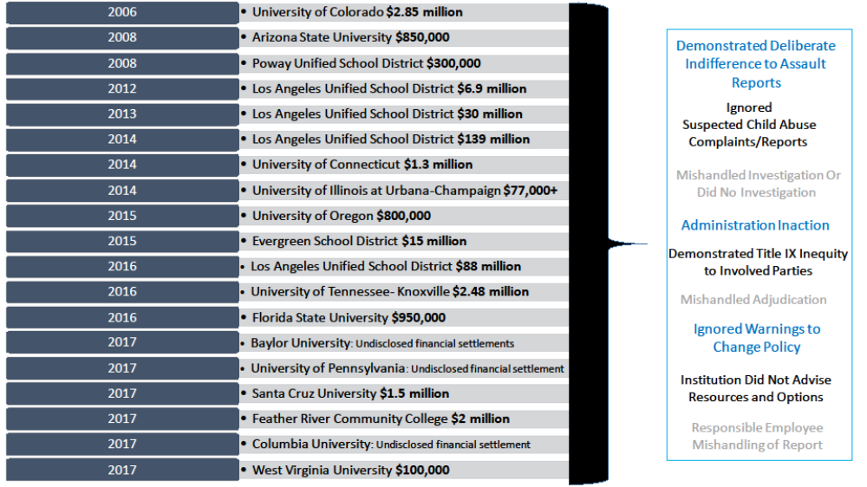
What non-compliance liability has looked like in recent years
© Copyright. Sandra E. Hodgin, 2018. All rights reserved.

Slide 8

IMPORTANT DETAILS STUDENTS SHOULD UNDERSTAND:
  Types of inappropriate behaviors to be aware of and what to report
  Where Title IX campus policies are located and what the policy describes
  Resources that are available on- and off- campus for both employees and students

Slide 9
Can Be Found @:
- University Policy Library http://policylibrary.colostate.edu/
- Support and Safety Assessment/Title IX Programs http://supportandsafety.colostate.edu/home.aspx
CSUs: Discrimination, Harassment, Sexual Harassment, Sexual Misconduct, Domestic Violence, Dating Violence, Stalking and Retaliation Policy

Slide 10
STUDENT RESOURCES
(ON- AND OFF- CAMPUS)
Confidential Support Off-Campus
Sexual Assault Victim Advocate Center (SAVA)
Provides counseling, crisis intervention, and advocacy services.
970‐472‐4200 (24-Hour Rape Crisis Hotline)
970‐472‐4204 (Fort Collins Office)
Crossroads Safehouse (Domestic Violence)
Provides counseling, crisis intervention, and advocacy services.
970-482-3502 (24-Hour Crisis Hotline)
970‐530‐2353 (Fort Collins Office)
Rape, Abuse & Incest National Network (RAINN)
Provides counseling by phone or live online communication.
1‐800‐656‐4673 (24-Hour National Crisis Hotline)
Online Chat: https://hotline.rainn.org/online
Non-Confidential Support On-Campus
Tell Someone
Tell Someone provides you professional access to discuss mental health or safety concerns that you may have about a student or employee on campus.
(970) 491-1350
Website: http://www.supportandsafety.colostate.edu/tellsomeone
Responsible Employees (CSU Faculty and Staff)
All CSU employees and volunteers are classified and designated as Responsible Employees. Responsible Employees are required to report any information related to incidents of sex-based discrimination, harassment, interpersonal violence, and/or retaliation involving students disclosed to them to the campus Title IX Coordinator.
Confidential Support On-Campus
CSU Health and Medical Center Counseling Services
Provides counseling and spiritual care services.
970‐491‐6053
970-491-7111 (After-hours)
Monday – Friday, 8am- 5pm.
Women’s Care Services at CSU Health Network
Provides women care services that includes but is not limited to woman examinations, birth control counseling, and sexual transmitted infection (STI) testing, counseling, and treatment.
970‐491‐1754
Monday – Friday, 8am- 5pm.
Women and Gender Advocacy Center: Victim Assistance Team (VAT)
Provides counseling, crisis intervention, and advocacy services.
970‐492‐4242 (24-Hour Hotline)
970‐491‐6384 (WGAC Office)
Monday – Friday, 8am-5pm.
Email: wgac@colostate.edu

Slide 11
Thank you!
“It takes a village to raise a child, also it takes a village to abuse one.”
-Spotlight (Faust et al., 2015).

